Slide 1
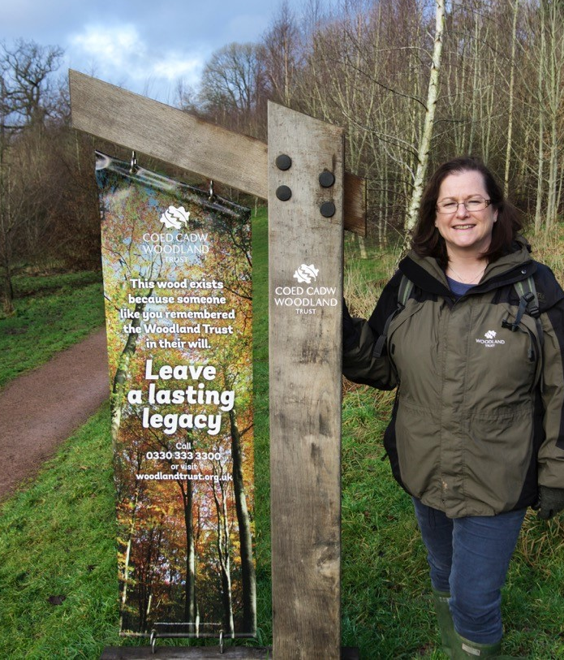
A community owned National Forest
Natalie Buttriss
Director – Cyfarwyddwraig

Slide 2
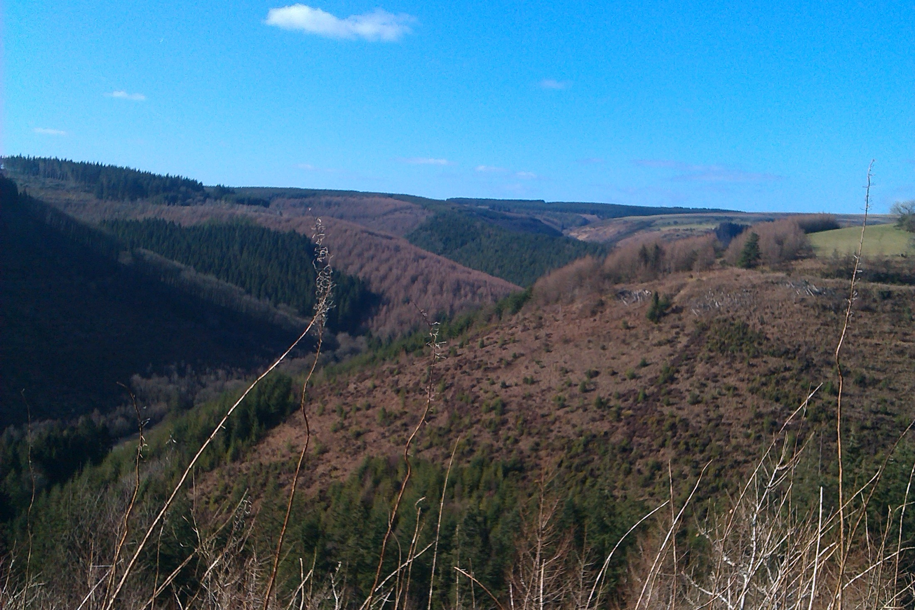
What do we mean by a forest?
Notes:
History versus modern definition:
Brechfa Forest - modern name for part of the ancient Glyn Cothi Forest, managed for centuries by local people to provide building materials, products, fuel and grazing – a mix of habitats (now part of the PFE and designated as a PAWS).
Caution re use of the word forest:
Learning the best from other UK forests
Making it a Fforest….(Mabinogian)
Usually word used to describe a large area of woodland as well as the ‘public forest estate’, managed by NRW on behalf of the government… There is endless debate over the definition!

Slide 3
Why now?

Slide 4
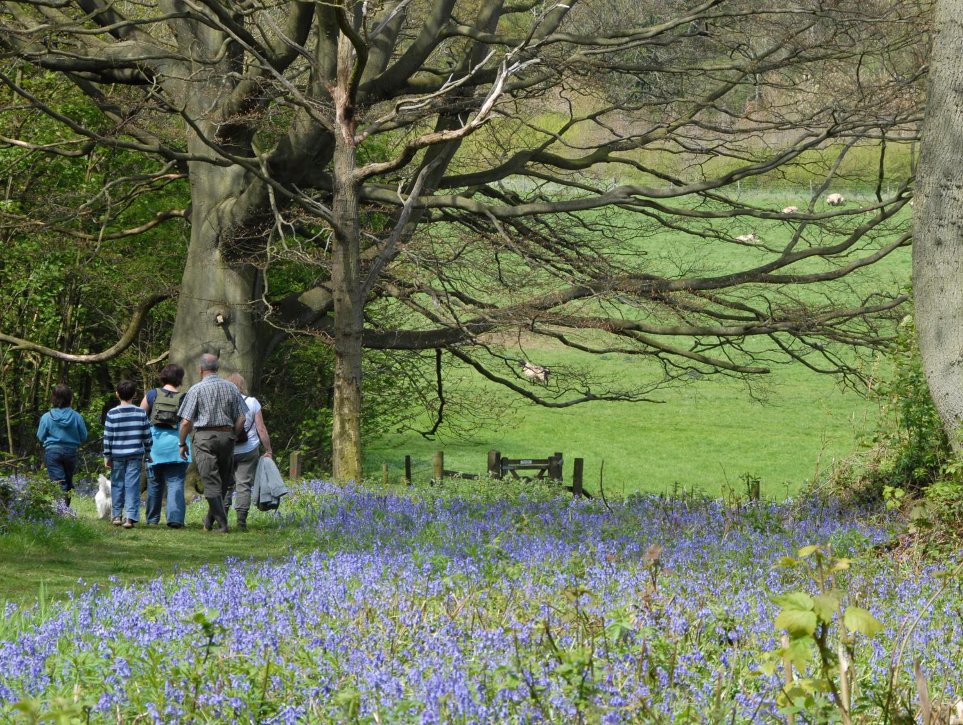
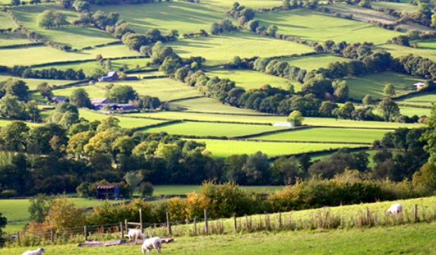
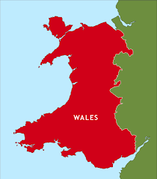
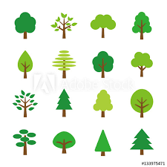
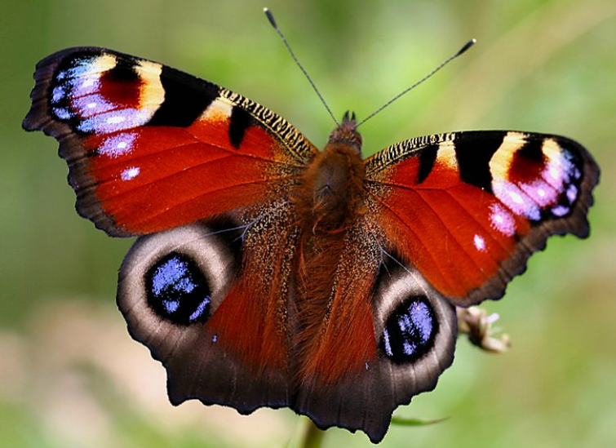
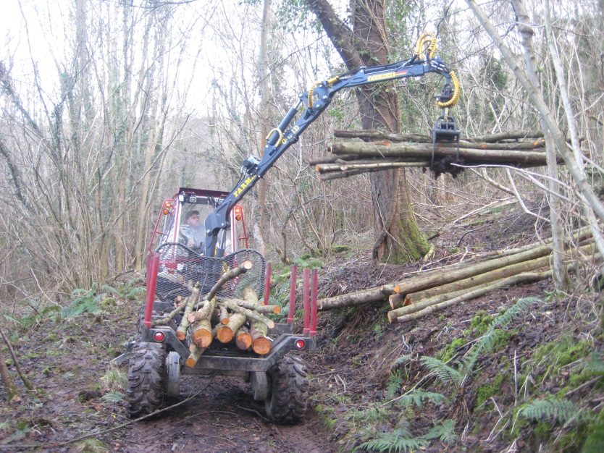
The WT vision

Slide 5
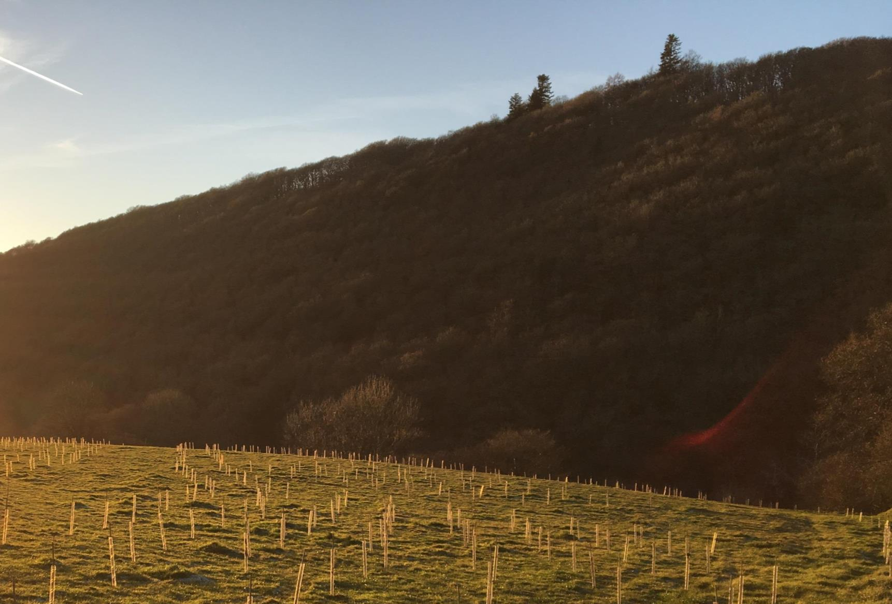
Bold and Ambitious
Woodland expansion
At least 5,000 ha
Per year
Increased canopy cover
From 15%
To over 20%
Easily accessible to all
Within 1 hour journey
Of everyone in wales

Slide 6
Connected

Slide 7
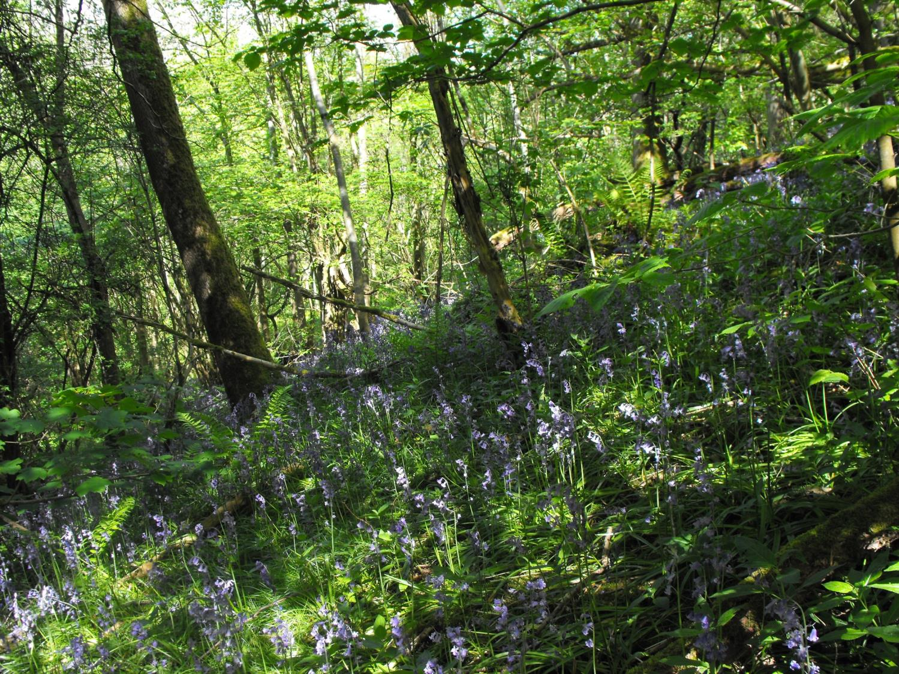
Urban and rural

Slide 8
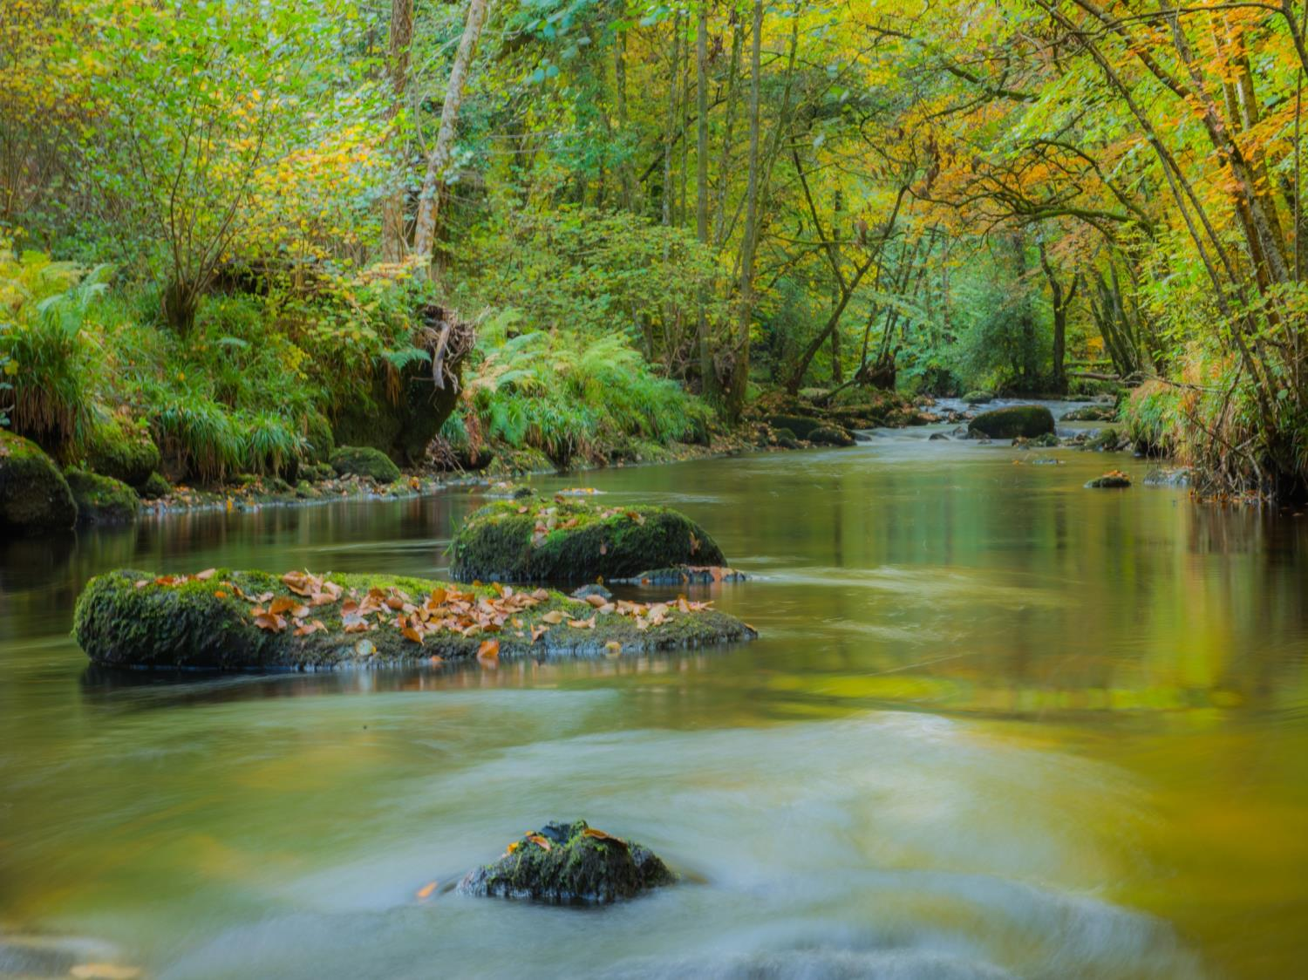
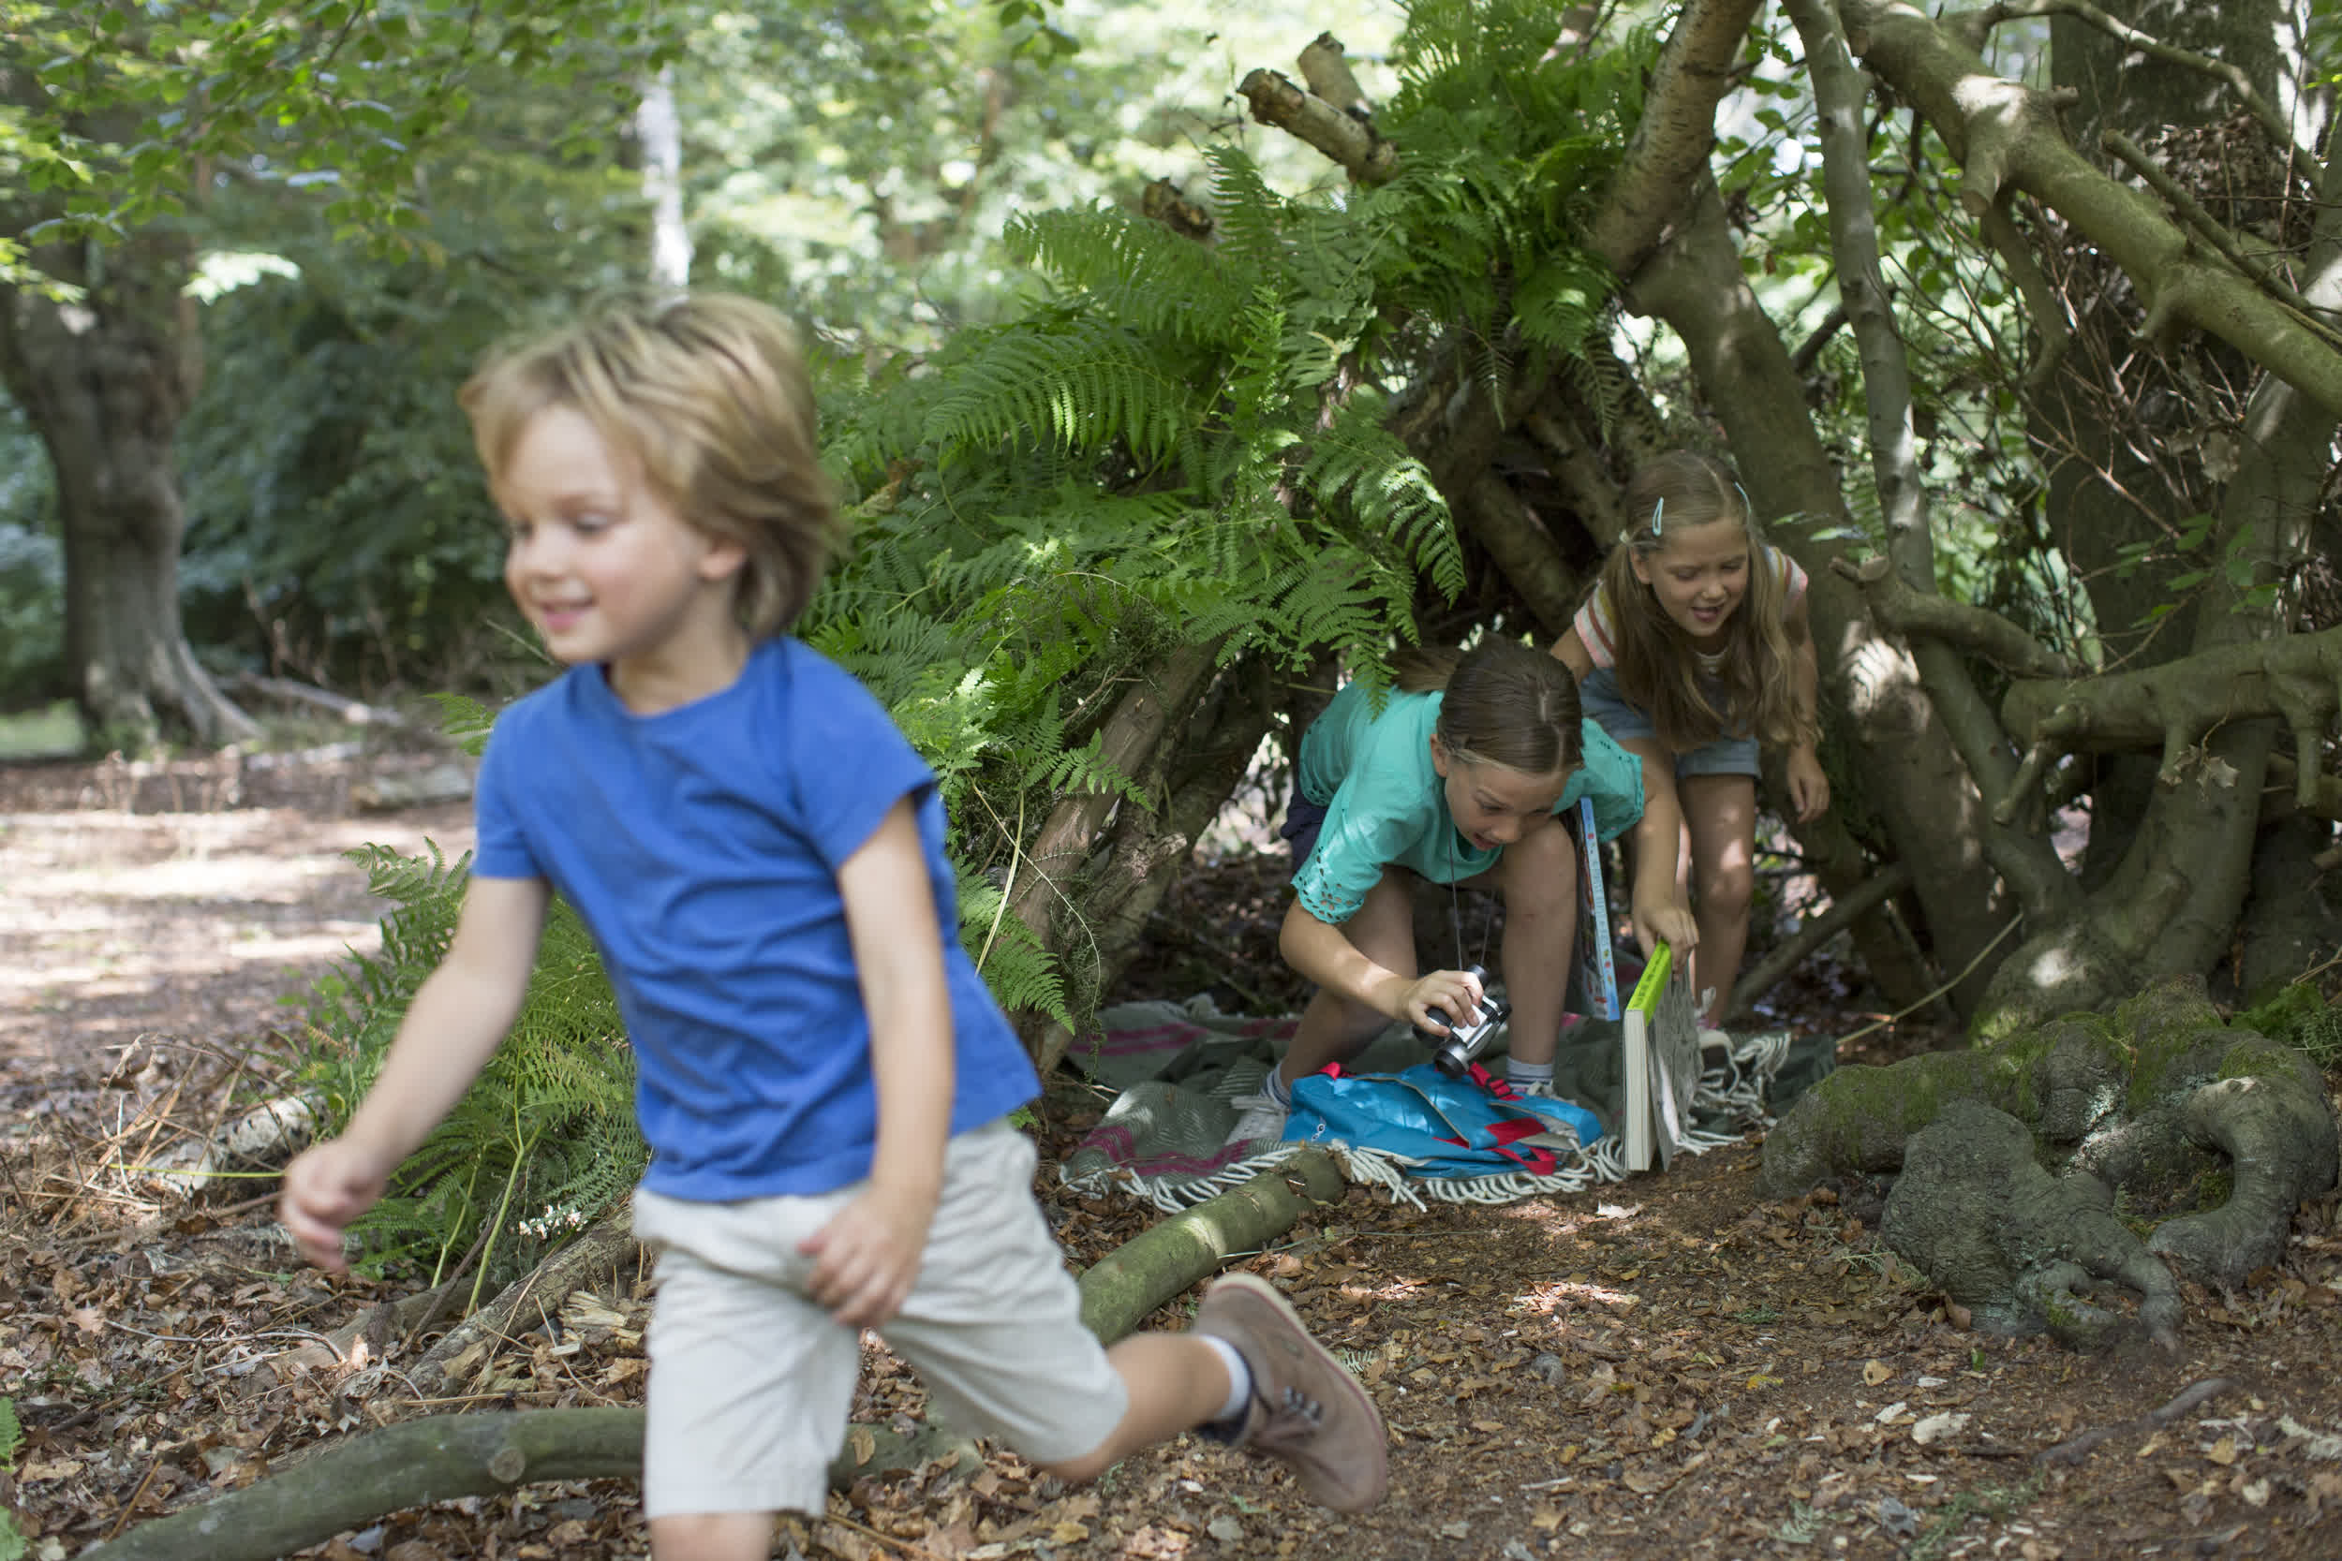
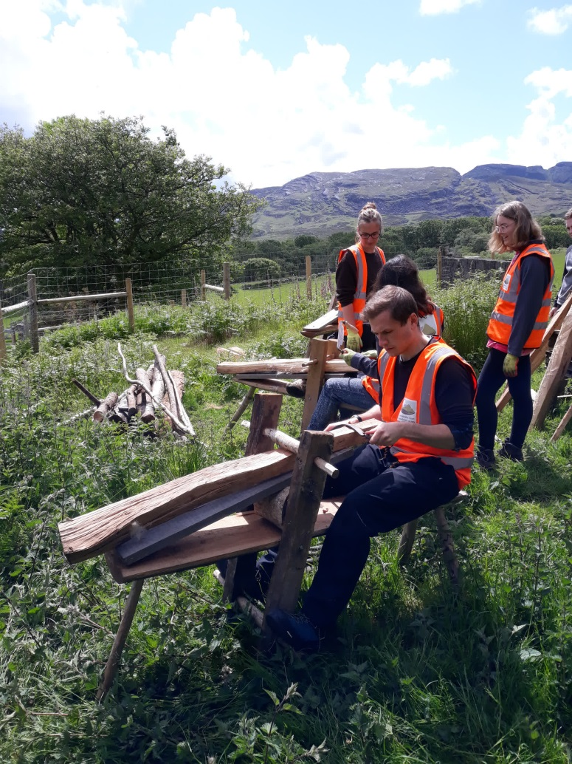
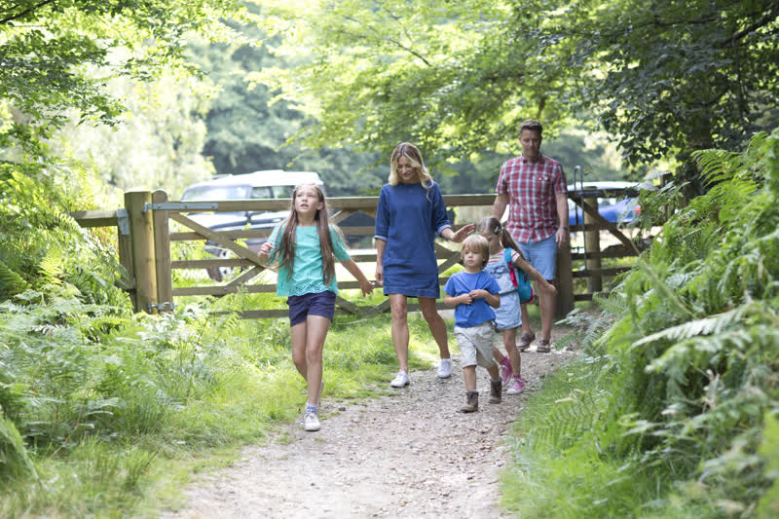
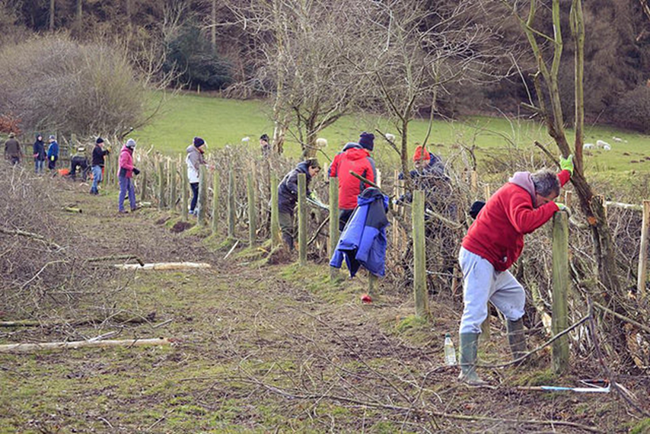
Multi-benefits

Slide 9
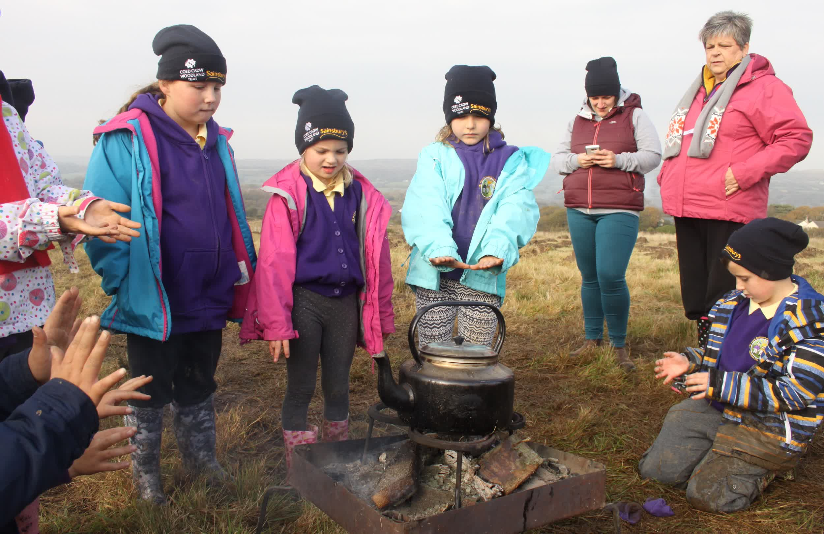
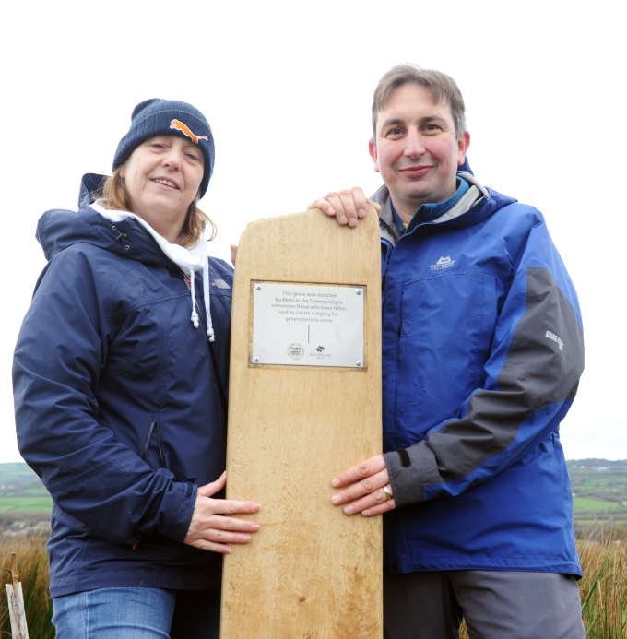
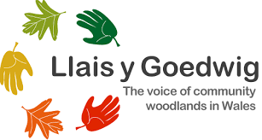
Multi-sector – Multi-funded

Slide 10
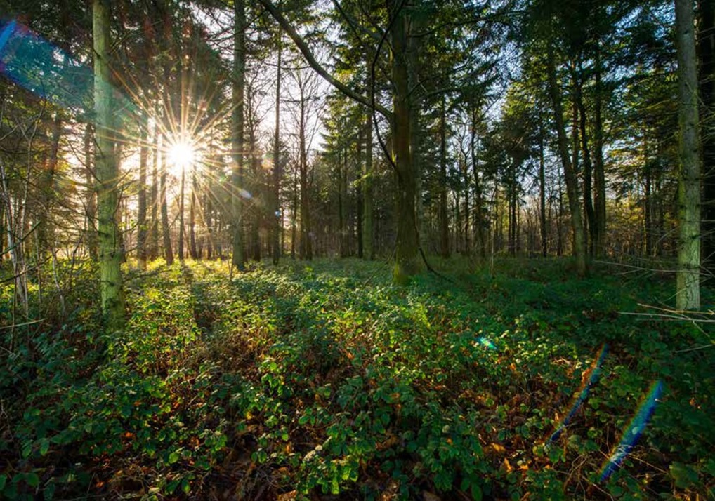
What next?
Diolch
Thank you

